Slide 1
Introduction to Python
Sachin Chorge
April 2022

Slide 2
Introduction to Python
Python is a general purpose language. Its one of the easiest languages to start your Data Science. Also, its simplicity does not limit your functional possibilities.
Python is a free and open-source language
It is an interpreted, high level programming language
It has an enormous community
Python has hundreds of different libraries and frameworks which will help you in development process. There are over 137,000 python libraries present today.

Slide 3
Basics of Python
Following are a few features of Python which differentiate it from other programming languages
Python statements do not need to end with a special character – the Python interpreter knows that you are done with an individual statement with the presence of a newline which gets generated when you press the ‘Return’ key of the keyboard.
If a statement spans more than one line, the safest course of action is to use a backslash (\) at the end of the line to let Python know that you are going to continue the statement on the next line.
Python uses indentation, that is, the amount of white space before the
statement itself, to indicate the presence of loops.
Object Oriented Programming: Python is an object-oriented language.

Slide 4
Top Libraries for Data Science
Pandas – used for data analysis, manipulation, cleaning etc.
Numpy – build in mathematical functions for quick computation and supports big matrices and multidimensional data
Scipy - used for scientific computing, data processing, and high-performance computing.
Scikit Learn - can be used with both supervised and unsupervised learning algorithms. The library includes popular algorithms as well as the NumPy, Matplotlib, and SciPy packages.
Keras – open-source neural network library that lets us experiment with deep neural networks quickly.
TensorFlow - was created by the Google Brain team researchers within the Google AI organization and is currently widely utilized by math, physics, and machine learning researchers for complicated mathematical computations.
The Other popular libraries include Pytorch – build by Facebook, LightGBM – mainly for Gradient Boosting Models.

Slide 5
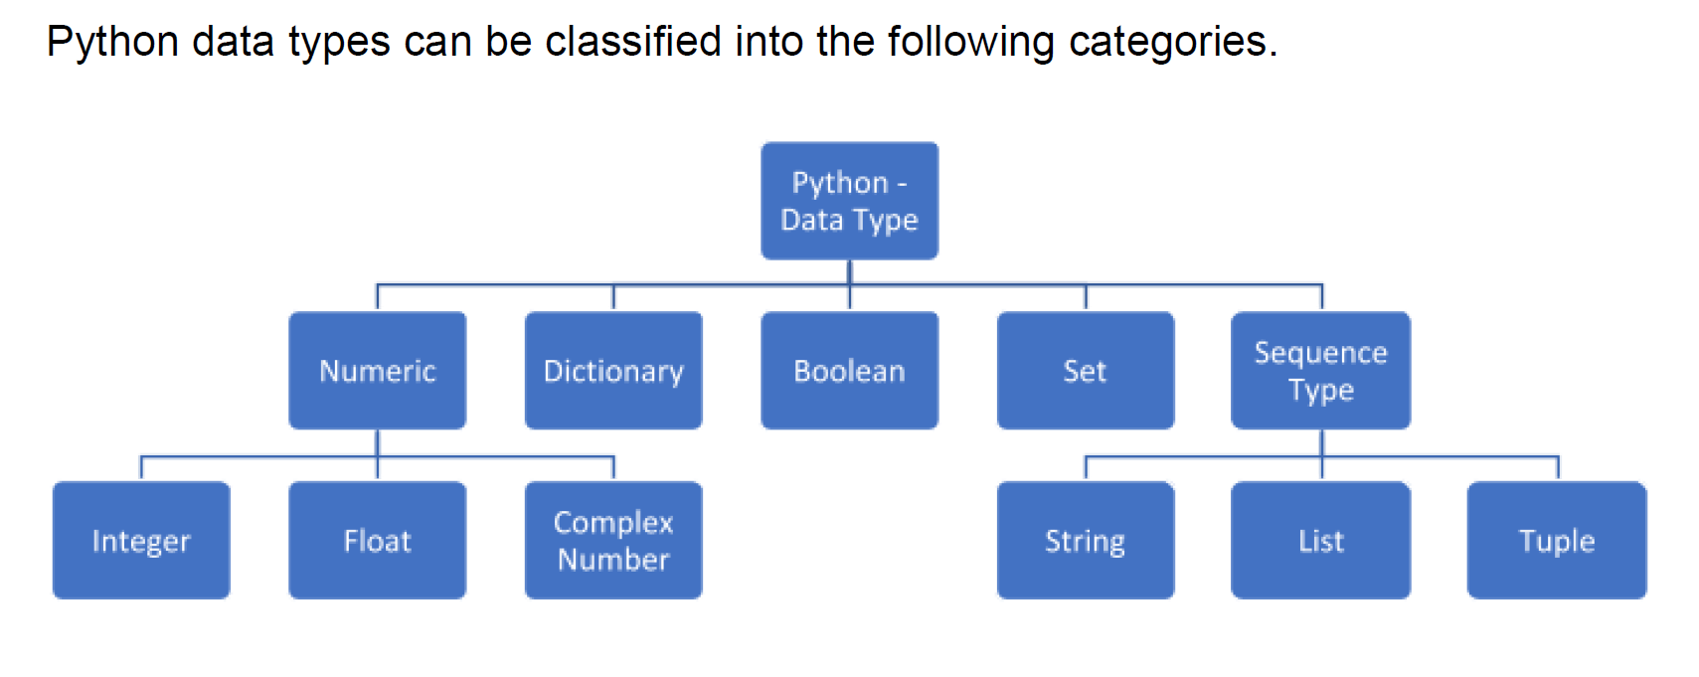
Data Types

Slide 6
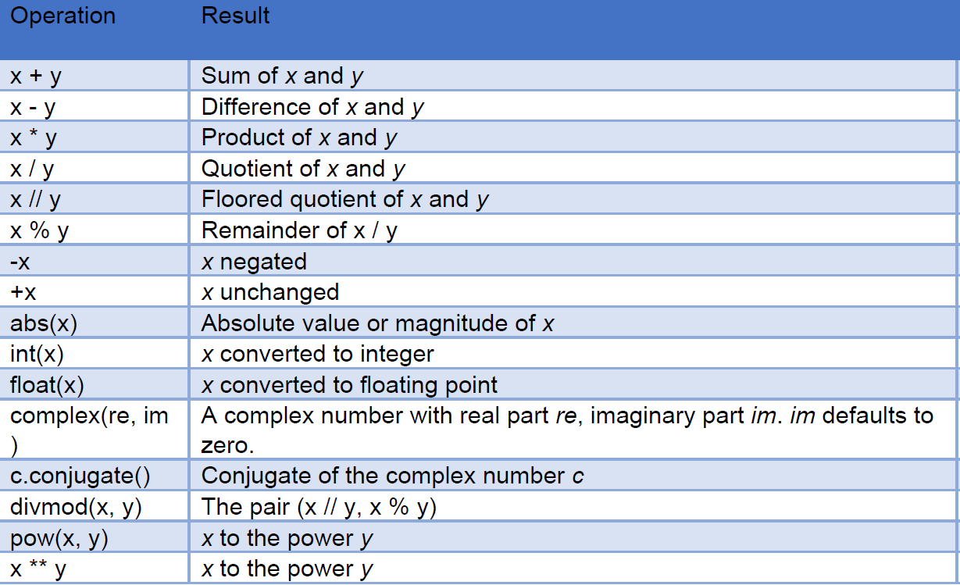
Data Types and Basic Operations

Slide 7
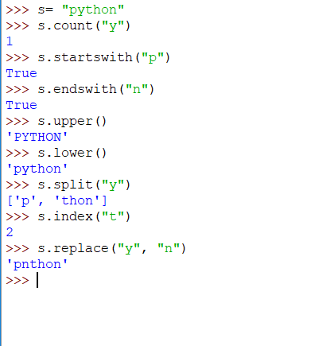
String Methods
s = ‘python’ , s= “python”
s = “”” This is
a multiline string”””
Count appearance of substrings: s.count(sub [, start[, end]])
Begins with a substring: s.startswith(sub[, start[, end]]) ,
Ends with a substring : s.endswith(sub[, start[, end]])
All capital/lowercase letters: s.upper() , s.lower()
Remove whitespace: s.strip()
Split at substring: s.split([sub [,maxsplit]])
Find position of substring: s.index(sub[, start[, end]])
Replace a substring: s.replace(old, new[, count])

Slide 8
Contd…
capitalize() Converts the first character to uppercase
casefold() Converts string into lowercase
center() Returns a centred string
count() Returns the number of times a specified value occurs in a string
encode() Returns an encoded version of the string
endswith() Returns true if the string ends with the specified value
expandtabs() Sets the tab size of the string
find() Searches the string for a specified value and returns the position of where it was found
format() Formats specified values in a string
format_map() Formats specified values in a string
index() Searches the string for a specified value and returns the position of where it was found
isalnum() Returns True if all characters in the string are alphanumeric
isalpha() Returns True if all characters in the string are in the alphabet
isdecimal() Returns True if all characters in the string are decimals
isdigit() Returns True if all characters in the string are digits
isidentifier() Returns True if the string is an identifier
islower() Returns True if all characters in the string are lower case
isnumeric() Returns True if all characters in the string are numeric
isprintable() Returns True if all characters in the string are printable
isspace() Returns True if all characters in the string are whitespaces
istitle() Returns True if the string follows the rules of a title
isupper() Returns True if all characters in the string are upper case
join() Joins the elements of an iterable to the end of the string
ljust() Returns a left justified version of the string
lower() Converts a string into lower case
lstrip() Returns a left trim version of the string
maketrans() Returns a translation table to be used in translations
partition() Returns a tuple where the string is parted into three parts
replace() Returns a string where a specified value is replaced with a specified value
rfind() Searches the string for a specified value and returns the last position of where it was found
rindex() Searches the string for a specified value and returns the last position of where it was found
rjust() Returns a right justified version of the string
rpartition() Returns a tuple where the string is parted into three parts
rsplit() Splits the string at the specified separator, and returns a list
rstrip() Returns a right trim version of the string
split() Splits the string at the specified separator, and returns a list
splitlines() Splits the string at line breaks and returns a list
startswith() Returns true if the string starts with the specified value
strip() Returns a trimmed version of the string
swapcase() Swaps cases, lowercase becomes uppercase and vice versa
title() Converts the first character of each word to uppercase
translate() Returns a translated string
upper() Converts a string into upper case
zfill() Fills the string with a specified number of 0 values at the beginning

Slide 9
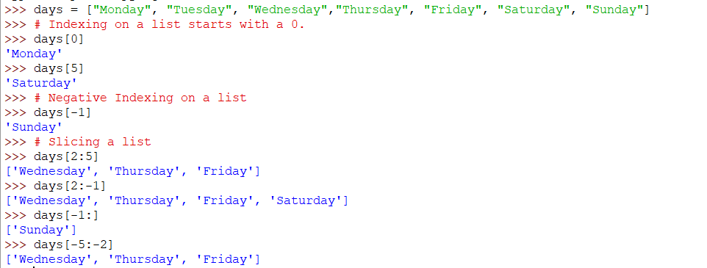
Lists
A list is a collection of values. List may contain different types of values.

Slide 10
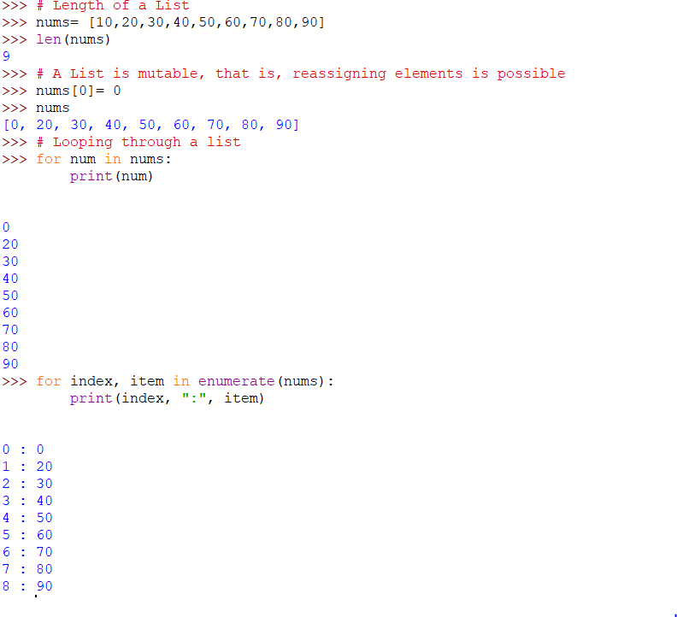
Lists

Slide 11
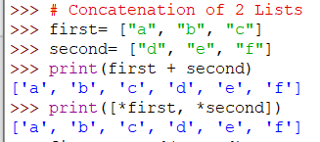
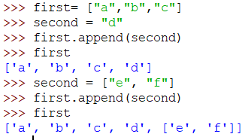
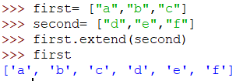
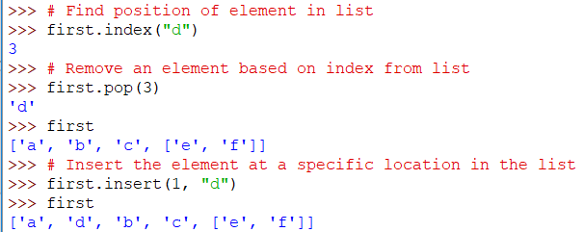
Lists

Slide 12
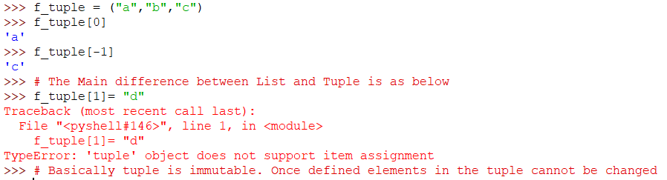
Tuples
A tuple is like a list. It uses parenthesis instead of square brackets.

Slide 13
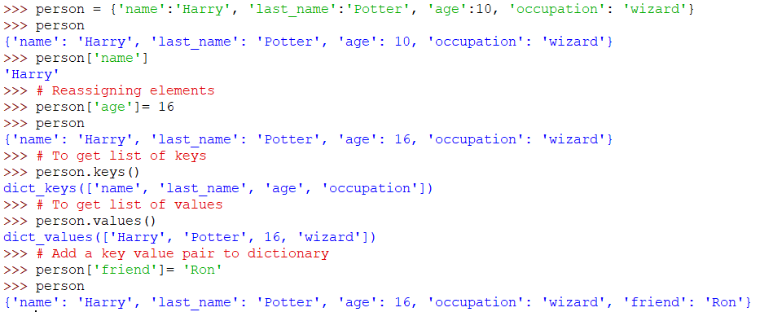
Dictionary
A Dictionary is a key – value pair.

Slide 14
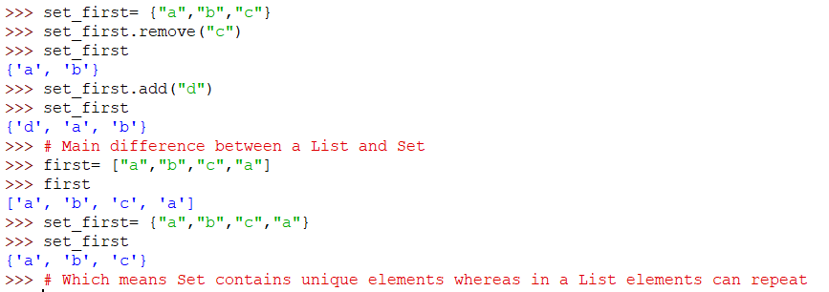
Sets
A Set can have a list of values defined using {}

Slide 15
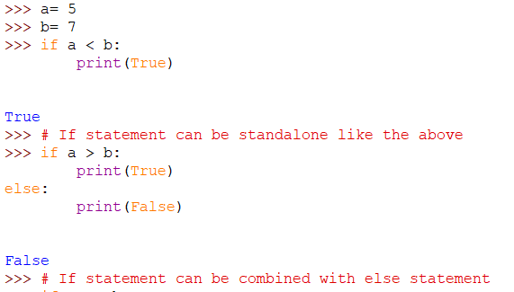
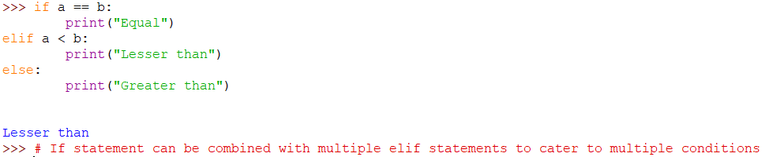
Conditional Statements – If-else

Slide 16
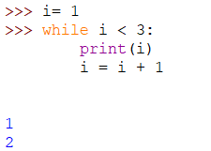
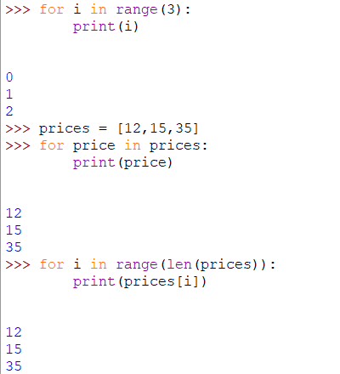
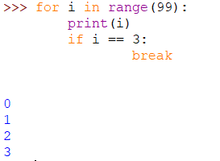
Loops
While Loop
For Loop
Break the Loop when required

Slide 17
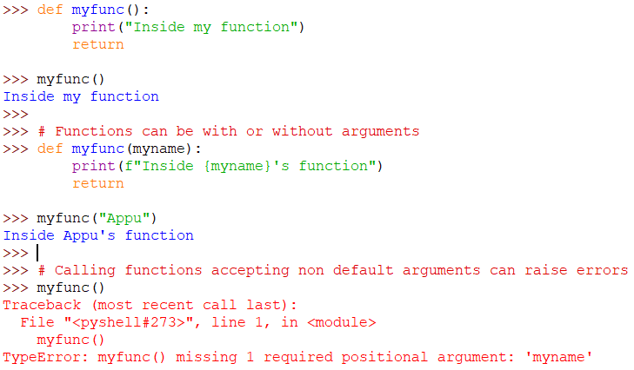
Functions
A function is a block of organized, reusable code used to perform a single, related action.
Functions provide better modularity for the application and a high degree of code reusing.

Slide 18
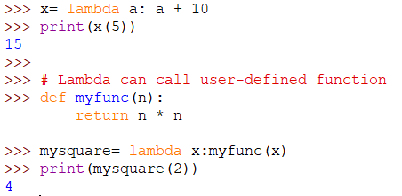
Lambda
A Lambda function is a small anonymous function, which can take any number of arguments. However, it can only have one expression.

Slide 19
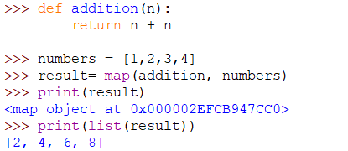
Map
Map applies a function to all the items in an input list.

Slide 20
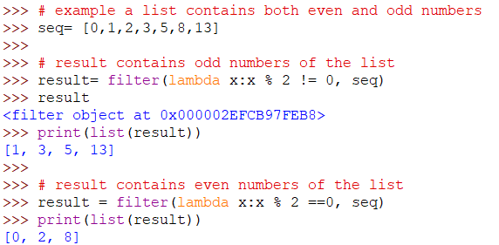
Filter
The filter() method filters the given sequence through a function that tests each element in the sequence to be true or not.

Slide 21
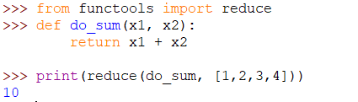
Reduce
The reduce() function accepts a function and a sequence, and returns a single value calculated through the following process:
1. Initially, the function is called with the first two items from the sequence, and the result is returned.
2. The function is then called again with the result obtained in step 1 and the next value in the sequence. This process keeps repeating until there are items in the sequence.

